Slide 1
Data Collection and Preprocessing
UNIT II

Slide 2
Getting data
There are several ways to get data:
Using stdin and stdout (in Python)
Using files
Scraping from the web
Using API’s

Slide 3
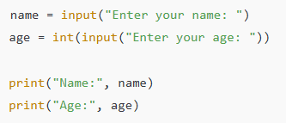
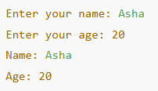
1. Using stdin and stdout (in Python) stdin (standard input) is used to take input from the user, and stdout (standard output) is used to display results.
Example:

Slide 4
# egrep.py
import sys, re
# sys.argv is the list of command-line arguments
# sys.argv[0] is the name of the program itself
# sys.argv[1] will be the regex specified at the command line
regex = sys.argv[1]
# for every line passed into the script
for line in sys.stdin:
# if it matches the regex, write it to stdout
if re.search(regex, line):
sys.stdout.write(line)

Slide 5
# line_count.py
import sys
count = 0
for line in sys.stdin:
count += 1
# print goes to sys.stdout
print count

Slide 6
You could then use these to count how many lines of a file contain numbers.
In Windows, you’d use:
type SomeFile.txt | python egrep.py "[0-9]" | python line_count.py
whereas in a Unix system you’d use:
cat SomeFile.txt | python egrep.py "[0-9]" | python line_count.py
The | is the pipe character, which means “use the output of the left command as the input of the right command.”

Slide 7

# most_common_words.py
import sys
from collections import Counter
# pass in number of words as first argument
try:
num_words = int(sys.argv[1])
except:
print "usage: most_common_words.py num_words"
sys.exit(1) # non-zero exit code indicates error
counter = Counter(word.lower() # lowercase words
for line in sys.stdin
for word in line.strip().split() # split on spaces
if word) # skip empty 'words'
for word, count in counter.most_common(num_words):
sys.stdout.write(str(count))
sys.stdout.write("\t")
sys.stdout.write(word)
sys.stdout.write("\n")

Slide 8
type sample.txt | python most_common_words.py 10
Try it yourself:
Print all words whose length is greater than or equal to a given number

Slide 9
# long_words.py
import sys
# get minimum word length from command line
try:
min_length = int(sys.argv[1])
except:
print("Usage: long_words.py min_length")
sys.exit(1)
# read input line by line
for line in sys.stdin:
words = line.strip().split()
for word in words:
if len(word) >= min_length:
sys.stdout.write(word)
sys.stdout.write("\n")

Slide 10
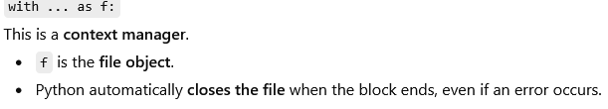
The Basics of Text Files
The first step to working with a text file is to obtain a file object using open:
file = open('reading_file.txt', 'r') # Options: 'r',’w’,’a’
file.close() # don't forget to close your files when you're done
Because it is easy to forget to close your files, you should always use them in a with block, at the end of which they will be closed automatically:
with open(filename,'r') as f:
data = function_that_gets_data_from(f)
process(data)

Slide 11
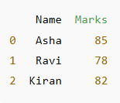
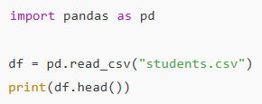
Using Files
Data can be stored in files (CSV, TXT, Excel) and read into a Python program for processing.
Example (Reading a CSV file):

Slide 12
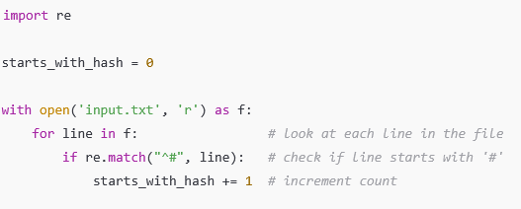
Reading a file line by line and counting lines starting with #

Slide 13

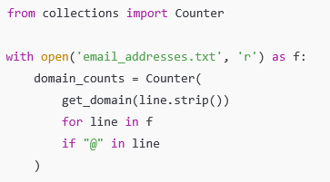
Extracting domains from email addresses & counting domain address

Slide 14
Try it yourself
Count File Extensions in a File List
Sample Input File: files.txt
Report.pdf
image.jpg
notes.txt
photo.jpg
summary.pdf
data.csv
script.py

Slide 15
from collections import Counter
def get_extension(filename):
#Return the file extension
if "." in filename:
return filename.lower().split(".")[-1]
return "no_extension"
with open("files.txt", "r") as f:
extension_counts = Counter(get_extension(line.strip())
for line in f
if line.strip()
)
for ext, count in extension_counts.items():
print(ext, count)

Slide 16
Example - Basics
with open("sample.txt", "r") as f:
for line in f:
print(line.strip())

Slide 17
Example - Basics
count = 0
with open("sample.txt", "r") as f:
for line in f:
count += 1
print("Number of lines:", count)

Slide 18
Example - Basics
word_count = 0
with open("sample.txt", "r") as f:
for line in f:
words = line.split()
word_count += len(words)
print("Total words:", word_count)

Slide 19
Example - Basics - Display lines containing a word
keyword = "python"
with open("sample.txt", "r") as f:
for line in f:
if keyword in line.lower():
print(line.strip())

Slide 20
Example - Basics - Read entire file at once
with open("sample.txt", "r") as f:
data = f.read()
print(data)

Slide 21
Example - Basics - Count blank lines in a file
blank_lines = 0
with open("sample.txt", "r") as f:
for line in f:
if line.strip() == "":
blank_lines += 1
print("Blank lines:", blank_lines)

Slide 22
Count vowels in a file
vowel_count = 0
vowels = "aeiouAEIOU"
with open("sample.txt", "r") as f:
for line in f:
for ch in line:
if ch in vowels:
vowel_count += 1
print("Total number of vowels:", vowel_count)

Slide 23
Print only lines starting with a capital letter
# Program to print lines starting with a capital letter
with open("sample.txt", "r") as f:
for line in f:
stripped_line = line.strip()
if stripped_line and stripped_line[0].isupper():
print(stripped_line)

Slide 24
Find the longest line in a file
longest_line = ""
max_length = 0
with open("sample.txt", "r") as f:
for line in f:
stripped_line = line.strip()
if len(stripped_line) > max_length:
max_length = len(stripped_line)
longest_line = stripped_line
print("Longest line:")
print(longest_line)
print("Length:", max_length)

Slide 25
Copy content from one file to another
with open("source.txt", "r") as source:
with open("destination.txt", "w") as destination:
for line in source:
destination.write(line)
print("Content copied successfully.")

Slide 26

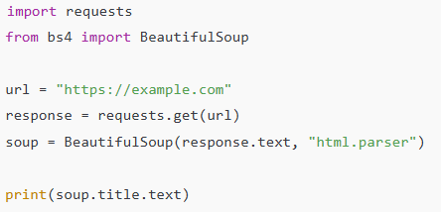
Scraping Data from the Web Web scraping is the process of automatically extracting data from websites using Python libraries.
Example (Simple web scraping):

Slide 27
Example - Basics
import requests
url = "https://example.com"
response = requests.get(url)
print(response.text)

Slide 28
Example - Basics - Extract page title
import requests
from bs4 import BeautifulSoup
url = "https://example.com"
html = requests.get(url).text
soup = BeautifulSoup(html, "html.parser")
print("Page Title:", soup.title.text)

Slide 29
Example - Basics - Extract all links from a webpage
import requests
from bs4 import BeautifulSoup
url = "https://example.com"
html = requests.get(url).text
soup = BeautifulSoup(html, "html.parser")
for link in soup.find_all("a"):
print(link.get("href"))

Slide 30
Try it yourself
Write a Python program to Extract headings (<h1>) from a webpage
Write a Python program to Save scraped data to a file

Slide 31
import requests
from bs4 import BeautifulSoup
url = "https://example.com" # URL of the webpage
response = requests.get(url) # Fetch the webpage content
soup = BeautifulSoup(response.text, "html.parser") # Parse HTML content
headings = soup.find_all("h1") # Find all <h1> tags
print("H1 Headings in the webpage:") # Print the headings
for h in headings:
print(h.text.strip())

Slide 32
import requests
from bs4 import BeautifulSoup
url = "https://example.com" # URL of the webpage
response = requests.get(url) # Fetch webpage content
soup = BeautifulSoup(response.text, "html.parser") # Parse HTML content
headings = soup.find_all("h1") # Extract all <h1> headings
with open("headings.txt", "w") as f: # Save headings to a file
for h in headings:
f.write(h.text.strip())
f.write("\n")
print("Scraped data saved to headings.txt")

Slide 33
Using APIs
Many websites and web services provide application programming interfaces (APIs),which allow you to explicitly request data in a structured format. This saves you the trouble of having to scrape them!
Because HTTP is a protocol for transferring text, the data you request through a web API needs to be serialized into a string format. Often this serialization uses JavaScriptObject Notation (JSON).
JavaScript objects look quite similar to Python dicts, which makes their string representations easy to interpret:
{ "title" : "Data Science Book",
"author" : "Joel Grus",
"publicationYear" : 2014,
"topics" : [ "data", "science", "data science"] }

Slide 34
Example
import json # imports json (Python’s Built-in module)
serialized = """{ # A multi-line string (triple quotes).
"title": "Data Science Book", # It contains data in JSON format.
"author": "Joel Grus",
"publicationYear": 2014,
"topics": ["data", "science", "data science"]
}"""
# Parse JSON to Python dictionary
deserialized = json.loads(serialized) # json.loads() converts JSON string → Python dictionary.
if "data science" in deserialized["topics"]:
print(deserialized)

Slide 35
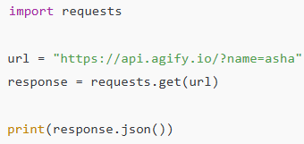
Using APIs
APIs (Application Programming Interfaces) allow programs to request data from external services in a structured format like JSON.
Example (Using a public API):

Slide 36
Most APIs (like: GitHub, Twitter, Google) require you to prove who you are before using them.
This is called authentication.
You usually authenticate using: API key, Access token, OAuth
But the example uses the GitHub public API, which allows some data without authentication.

Slide 37
import requests
# GitHub username
username = "h123" # You can change this
# API URL
url = f"https://api.github.com/users/{username}/repos" #Give me all public repositories of this user.
# Send request to GitHub API
response = requests.get(url)
# Convert JSON response to Python list
repos = response.json() # Converts JSON data → Python object, list of dictionaries.
# Print repository names
for repo in repos: # repo represents one dictionary at a time.
print(repo["name"])

Slide 38
With loads()
import json
text = '{"name": "John", "age": 25}' # This is a JSON string
data = json.loads(text) # Convert string → Python dictionary
print(data["name"])

Slide 39
If You Wanted to Use json.loads() Manually
import requests
import json
response = requests.get(url)
text_data = response.text # JSON string
repos = json.loads(text_data) # Convert to Python object

Slide 40
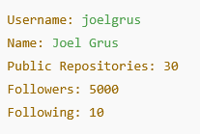
import requests
# GitHub username
username = "joelgrus"
# API URL for user details
url = f"https://api.github.com/users/{username}"
# Send GET request
response = requests.get(url)
# Convert JSON response to Python dictionary
user_data = response.json()
# Print selected details
print("Username:", user_data["login"])
print("Name:", user_data["name"])
print("Public Repositories:", user_data["public_repos"])
print("Followers:", user_data["followers"])
print("Following:", user_data["following"])

Slide 41
import requests
from dateutil.parser import parse
from collections import Counter
# Step 1: Define API endpoint
username = "joelgrus" # You can replace with your GitHub username
endpoint = f"https://api.github.com/users/{username}/repos"
# Step 2: Send GET request to GitHub API
response = requests.get(endpoint)
# Step 3: Convert JSON response to Python list
repos = response.json()
# Step 4: Extract creation dates and convert to datetime objects
dates = [parse(repo["created_at"]) for repo in repos]
# Step 5: Count repositories by month
month_counts = Counter(date.month for date in dates)
# Step 6: Count repositories by weekday
weekday_counts = Counter(date.weekday() for date in dates)
# Step 7: Sort repositories by creation date (latest first)
last_5_repositories = sorted(
repos,
key=lambda r: r["created_at"],
reverse=True
)[:5]
# Step 8: Extract languages of last 5 repositories
last_5_languages = [repo["language"] for repo in last_5_repositories]
# Step 9: Print Results
print("Total repositories:", len(repos))
print("Repositories per month:", month_counts)
print("Repositories per weekday (0=Mon, 6=Sun):", weekday_counts)
print("Languages of last 5 repositories:", last_5_languages)

Slide 42
When you need data from a website:
Go to the website.
Look for sections like:
Developers
API
Documentation
3. Search online: python <website name> api
Often, someone has already created a Python library (wrapper) for that API.
For example: Movie APIs (like Rotten Tomatoes), Restaurant APIs (like Yelp), Social influence APIs (like Klout), Movie database APIs (like IMDB).

Slide 43
Using the Twitter API
Twitter does not allow anonymous access.You must create:
Consumer Key
Consumer Secret
Access Token
Access Token Secret
These act like passwords.
They tell Twitter:
Which application is accessing data
Which user is accessing data

Slide 44
Using Twitter Search API
#Twython is a Python wrapper for the Twitter API.
# It allows us to interact with Twitter easily.
from twython import Twython
# This creates a connection to Twitter.
twitter = Twython(CONSER_KEY, CONSUMER_SECRET)
# This sends a search request to Twitter. q= query; findall tweets having “data science”
for status in twitter.search(q='"data science"')["statuses"]:
print(status["text"])

Slide 45
# A string containing emoji and non-English text
tweet = "I love Data Science 😊🔥 नमस्ते"
# Printing normally (Python 3 handles Unicode well)
print("Normal print:")
print(tweet)
# Encoding into UTF-8 format
encoded_tweet = tweet.encode("utf-8")
print("\nAfter encoding:")
print(encoded_tweet)
decoded_tweet = encoded_tweet.decode("utf-8")
print("\nAfter decoding:")
print(decoded_tweet)

Slide 46
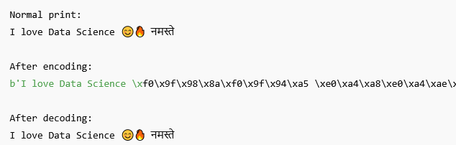
Output
b = bytes object

Slide 47
Exploring One-Dimensional Data
The simplest case is when you have a one-dimensional data set, which is just a collection of numbers.
For example, these could be the daily average number of minutes each user spends on using their phone, the number of times a collection of data science tutorial videos was watched etc.
An obvious first step is to compute a few summary statistics. You’d like to know how many data points you have, the smallest, the largest, the mean, and the standard deviation.
But even these don’t necessarily give you a great understanding. A good next step is to create a histogram, in which you group your data into discrete buckets and count how many points fall into each bucket:

Slide 48
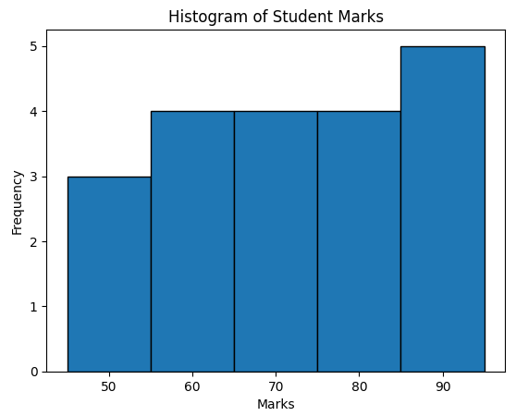
import numpy as np
import matplotlib.pyplot as plt
# Create one-dimensional data (marks of students)
data = np.array([45, 50, 55, 60, 65, 70, 75, 80, 85, 90,
52, 58, 63, 67, 72, 78, 82, 88, 91, 95])
print(data)
# Calculate frequencies and bins
frequency, bins = np.histogram(data, bins=5)
print(bins)
print("Frequencies:")
print(frequency)
# Plot histogram
plt.hist(data, bins=5, edgecolor='black') # added edgecolor for clarity
plt.title("Histogram of Student Marks")
plt.xlabel("Marks")
plt.ylabel("Frequency")
plt.show()

Slide 49
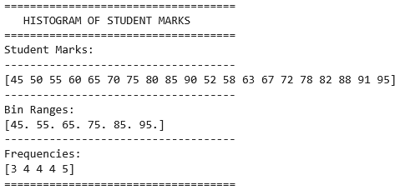
Contd..

Slide 50
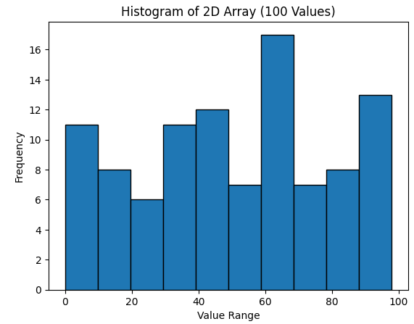
Two dimensional array
import numpy as np
import matplotlib.pyplot as plt
# Create 2D array (10 × 10 = 100 values)
data = np.random.randint(0, 100, (10, 10))
print("Two-Dimensional Array:")
print(data)
# Convert 2D → 1D
flat_data = data.flatten()
# Plot histogram
plt.hist(flat_data, bins=10, edgecolor='black')
plt.title("Histogram of 2D Array (100 Values)")
plt.xlabel("Value Range")
plt.ylabel("Frequency")
plt.show()

Slide 51
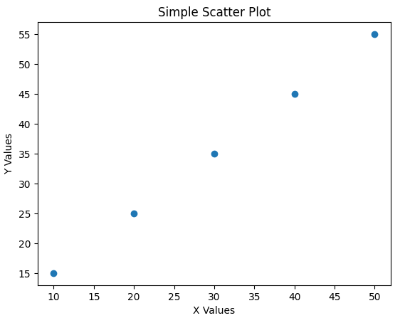
import matplotlib.pyplot as plt
# Sample data
x = [10, 20, 30, 40, 50]
y = [15, 25, 35, 45, 55]
# Create scatter plot
plt.scatter(x, y)
# Add labels and title
plt.xlabel("X Values")
plt.ylabel("Y Values")
plt.title("Simple Scatter Plot")
# Display the plot
plt.show()

Slide 52
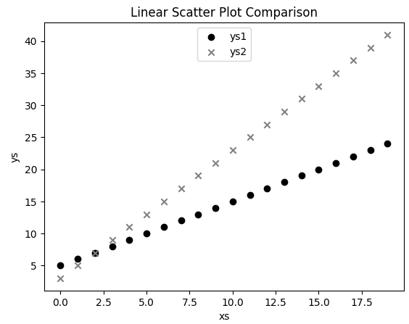

Slide 53
import matplotlib.pyplot as plt
x = [1, 2, 3, 4, 5]
y = [2, 4, 1, 3, 5]
x1 = [1, 2, 3, 4, 5]
y1 = [5, 3, 4, 2, 1]
plt.scatter(x, y, color='blue', marker='o', label='Set 1')
plt.scatter(x1, y1, color='red', marker='s', label='Set 2')
plt.xlabel("X-axis")
plt.ylabel("Y-axis")
plt.title("Scatter Plot of Two Data Sets")
plt.show()

Slide 54
Data Cleaning
Real-world data is messy (dirty). Before using it in a program, we must clean and fix it.
Data problems may include:
Numbers stored as text (strings)
Missing values
Wrong values (like year 3014 instead of 2014)
“n/a” instead of numbers
Typing mistakes
If we don’t clean the data, our program may:
Crash
Give wrong results

Slide 55
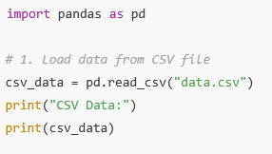
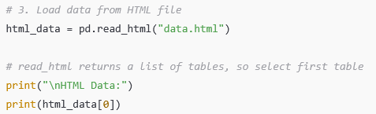
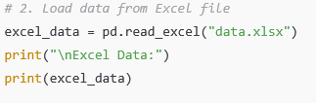

Slide 56
Write a Python program to detect outliers and perform string manipulation.
import pandas as pd
# Sample data
df = pd.DataFrame({
"Name": ["anita", "rahul", "kiran", "meena"],
"Marks": [80, 85, 200, 75] # 200 is an outlier
})
# Detect and remove outliers using simple condition
df = df[df["Marks"] < 100]
# String manipulation
df["Name"] = df["Name"].str.capitalize()
print(df)

Slide 57
Converting Strings to Numbers
When reading a CSV file, everything is read as text (string).
Example:
closing_price = float(row[2])
This converts a string like "90.91" into a number 90.91.
But doing this manually every time can cause errors.
So instead, we create a system that automatically converts columns properly while reading the file.

Slide 58
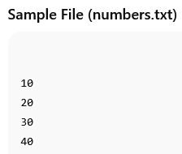
# Open the file in read mode
file = open("numbers.txt", "r")
# Read all lines from file
lines = file.readlines()
# Convert each line (string) into integer
numbers = [int(line.strip()) for line in lines]
# Close the file
file.close()
# Display the integers
print("Numbers:", numbers)
print("Sum:", sum(numbers))

Slide 59
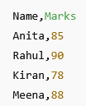

# Open the file
with open("data.txt", "r") as file:
lines = file.readlines()
# Skip header
lines = lines[1:]
marks = []
# Extract and convert second column to integer
for line in lines:
parts = line.strip().split(",")
mark = int(parts[1]) # Convert Marks column to integer
marks.append(mark)
print("Marks as integers:", marks)
print("Total Marks:", sum(marks))

Slide 60
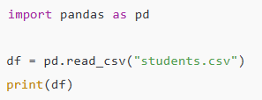

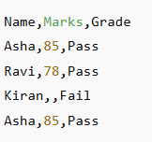
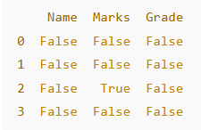
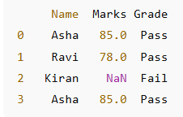
Data Manipulation using Pandas
students.csv

Slide 61


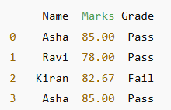
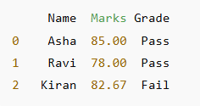
Filling Missing Data Removing Duplicates

Slide 62
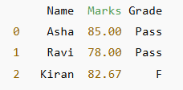

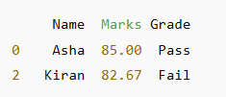




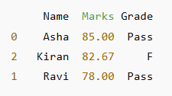
Filtering Data

Slide 63



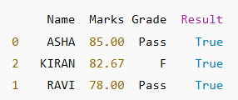
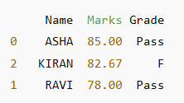
String Manipulation

Slide 64
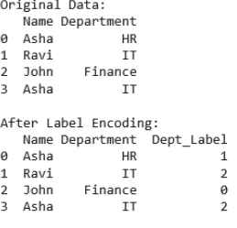
import pandas as pd
from sklearn.preprocessing import LabelEncoder
# Sample Data
data = pd.DataFrame({
"Name": ["Asha", "Ravi", "John", "Asha"],
"Department": ["HR", "IT", "Finance", "IT"]
})
print("Original Data:") print(data)
# Label Encoding
le = LabelEncoder()
data["Dept_Label"] = le.fit_transform(data["Department"])
print("\nAfter Label Encoding:") print(data)

Slide 65
from sklearn.model_selection import train_test_split
from sklearn.linear_model import LinearRegression
from sklearn.metrics import mean_squared_error
# Sample data
X = [[1], [2], [3], [4], [5]] # input
y = [2, 4, 1, 3, 5] # target
# Split into train and test
X_train, X_test, y_train, y_test = train_test_split(X, y, test_size=0.2, random_state=42)
# Create model
model = LinearRegression()
model.fit(X_train, y_train) # Train
# Predict
y_pred = model.predict(X_test)
# Evaluate
print("MSE:", mean_squared_error(y_test, y_pred))

Slide 66
import pandas as pd
from sklearn.preprocessing import MinMaxScaler, StandardScaler
data = pd.DataFrame({
"Salary": [25000, 40000, 50000, 60000, 80000]
})
print("Original Data:")
print(data)
# Normalization (0 to 1)
minmax = MinMaxScaler()
data["Normalized"] = minmax.fit_transform(data[["Salary"]])
# Standardization (Mean=0, Std=1)
standard = StandardScaler()
data["Standardized"] = standard.fit_transform(data[["Salary"]])
print("\nAfter Scaling:")
print(data)

Slide 67
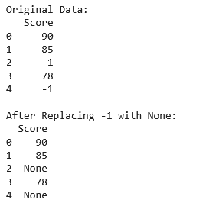
import pandas as pd
data = pd.DataFrame({
"Score": [90, 85, -1, 78, -1]
})
print("Original Data:")
print(data)
# Replace -1 with NaN
data["Score"] = data["Score"].replace(-1, None)
print("\nAfter Replacing -1 with None:")
print(data)

Slide 68
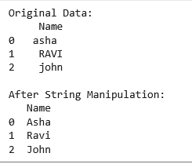
import pandas as pd
data = pd.DataFrame({
"Name": [" asha ", "RAVI", "john"]
})
print("Original Data:")
print(data)
# String operations
data["Name"] = data["Name"].str.strip() # remove spaces
data["Name"] = data["Name"].str.lower() # convert to lowercase
data["Name"] = data["Name"].str.capitalize() # capitalize first letter
print("\nAfter String Manipulation:")
print(data)

